Slide 1
Cellular Regulation
(SC/BIOL 4150 3.0)
F2021
Prerequisites:
SC/BIOL2020 4.0; SC/BIOL2021 4.0

Slide 2
Welcome to BIOL4150
Course Description: A detailed examination of molecular, cellular and physiological processes associated with the action of peptide hormones, neuro-transmitters and growth factors. Emphasis is on cell receptors and signal transduction mechanisms from the membrane to the nucleus.
Contact: mscheid@yorku.ca. Please place “RE: 4150” in the subject line. I will be using a Filter to collect the emails, so you MUST put RE: 4150 in the subject line.

Slide 3
Course Delivery
I have elected to deliver a portion of this course in-person. We will discuss during our Thursday September 9 Zoom meeting. (Did you read the notice from the University that Sept 7 – Sept 12 is remote)? Nothing is carved in stone, for the first two weeks of class this syllabus could change.
I will deliver the Tuesday lectures remotely through Zoom. These sessions will be recorded and posted within 24 hours.
Thursday periods will be in-person, and will include a lecture and a question-answer period on the material. I will try to simulcast the lecture through Zoom for students who are not able to attend (international students, for example) or do not want to travel to campus because of COVID19.
You MUST register each week by Tuesday to attend the Thursday lecture. If the interest in attending Thursday’s drop below 20% of the current enrolled numbers, I will pivot to online only.

Slide 4
Course evaluation
Midterm Exam 1 (25%) – October 19
80 minutes. Short answer, multiple choice – Remote through eClass. Open book, but you may not use group chat, tutoring sites or collaboration.
Midterm Exam 2 (25%) – November 16
80 minutes. Short answer, multiple choice – Remote through eClass. Open book, but you may not use group chat, tutoring sites or collaboration.
Final Exam (50%)
The Final exam will be 2-hours, multiple choice and short answer. The exam material could include anything covered in the course.
The Final exam is tentatively scheduled for in-person during the exam period. This could change depending on COVID19 restrictions. International students who are not in Canada may request by the end of the last class to write the exam remotely. I will not accept other requests besides documented medical accommodations.

Slide 5
Academic Integrity: Senate Policy on Academic Dishonesty
Students are expected to be familiar with and follow
York University’s Policies regarding academic integrity.
Please consult the website below for more details:
http://www.yorku.ca/academicintegrity/students.htm

Slide 6
Learning approach: This course will be taught using the primary literature and various online resources. There is no textbook.
Some examples:
Pubmed (https://www.ncbi.nlm.nih.gov/pubmed/)
Bookshelf (https://www.ncbi.nlm.nih.gov/books)
Journals (Cell.com, Nature.com, Science.com)

Slide 7
Biology review needed for this course
You should be familiar and able to describe and evaluate many of the cell biology methods and protocols you have learned previously, including:
Southern blot, Western blot, Northern blot, PCR, Knockout mouse, transgenic mouse, RNA interference, CRISPR

Slide 8
Biology review needed for this course
You should be familiar with the fundamentals of molecular biology including RNA transcription and transcriptional activation, DNA replication, DNA modification, protein modification, and the general structure of a cell.

Slide 9
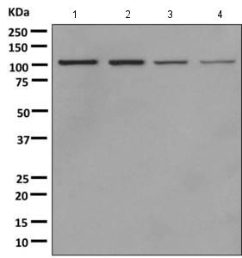
www.abcam.com

Slide 10
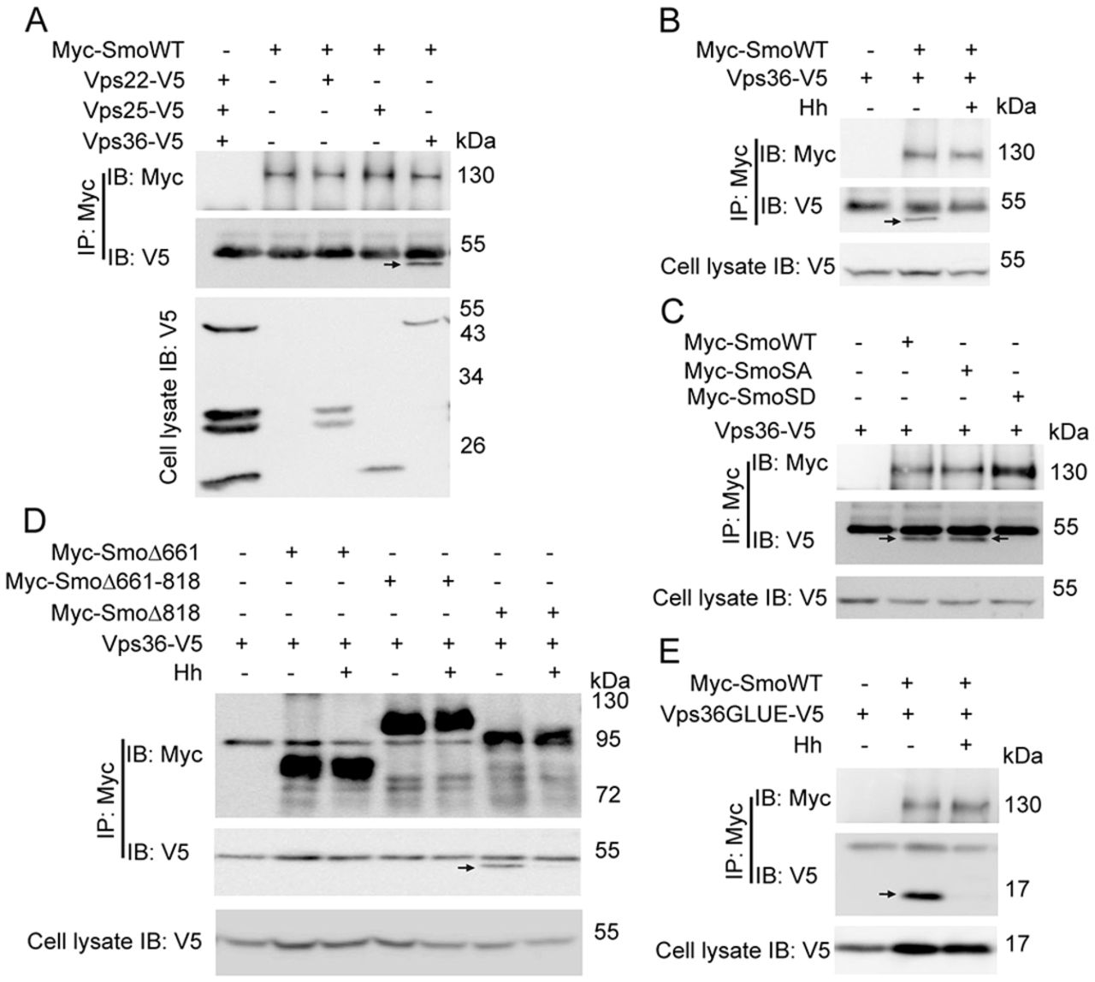

Slide 11
Epitope tags
FLAG
V5
Myc
HA

Slide 12
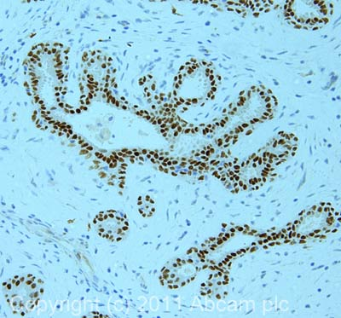
www.abcam.com

Slide 13
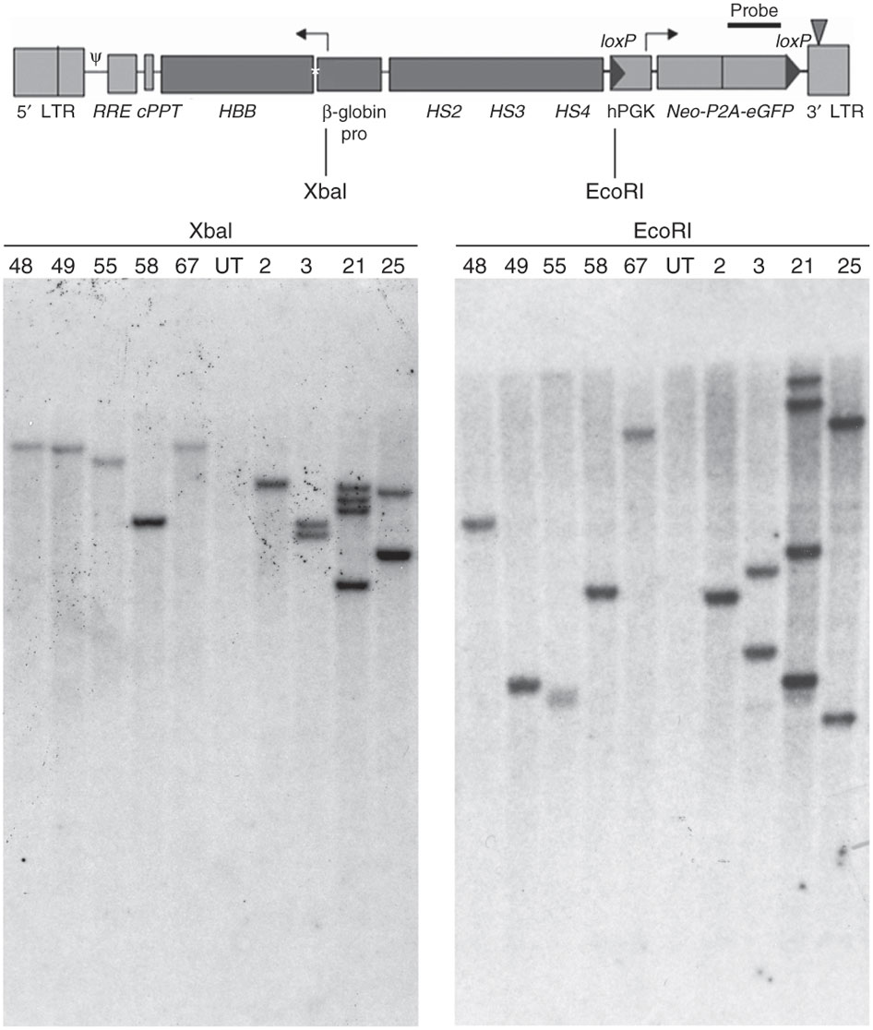
Derivation of genetically modified human pluripotent stem cells with integrated transgenes at unique mapped genomic sites
Eirini P Papapetrou & Michel Sadelain, Nature Protocols 6, 1274–1289 (2011)

Slide 14
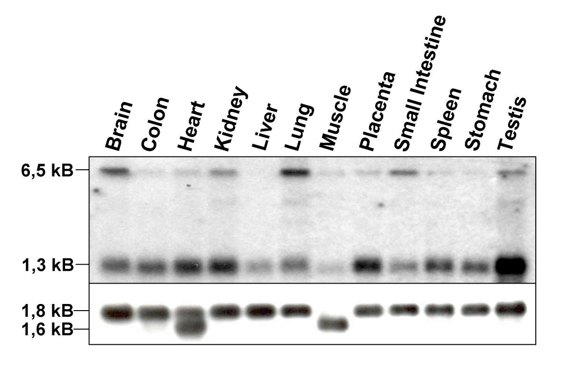
Lindfors et al. BMC Genomics 2003 4:53 doi:10.1186/1471-2164-4-53

